Slide 1
ECE 333 Green Electric Energy
Demand-Side Management & Smart Grid
Dr. Karl Reinhard
Dept. of Electrical and Computer Engineering
University of Illinois at Urbana-Champaign
reinhrd2@illinois.edu

Slide 2
Announcements
Final Exam 8 May, Rm 1013 ECE Bldg, 0800-1100
Quiz 10, Thursday, 26 April
Reading
Section 6.5 O-grid PV Systems with Battery Storage
Section 8.5 Hydroelectric Power
Section 9.4 Demand Side Management
Review (as needed)
Section 1.6 Financial Aspects (excluding sub-section 1.6.5)
Sections 6.4.1 6.4.3 PV Economics
Section 7.9 Wind Turbine Economics
Appendix A, Energy Economics Tutorial

Slide 3
Distributed Generation (DG)
Provide small increments in generation which can track load growth closely to reduce costs of unused capacity
Can ease bottlenecks in distribution networks
Improve voltages
Improve power factor
Reduce losses
Provide power during outages
Reduce emissions
But they lose economics of scale!
Notes:
2

Slide 4
Demand - Side Management
Also called “demand side resources” - any program that attempts to modify customer’s energy use
Conceptually, lowering the load is a source of energy – you can either raise generation or lower load
These programs have been around for decades
Ameren currently pays $50 per frig (2001 or earlier)
Notes:
3

Slide 5
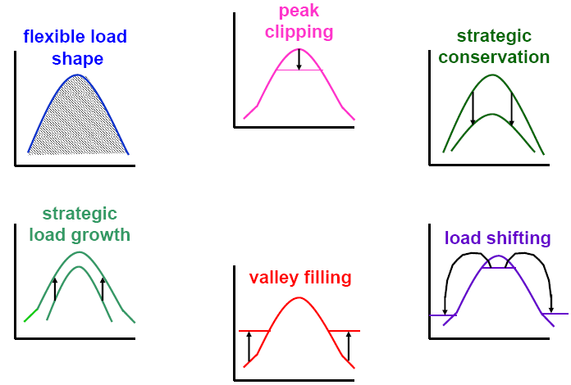
Demand – Side Management
Efficiency improvement
Conservation programs
Load management programs
Fuel substitution programs
Load Shape Objectives in DSM
Notes:
4

Slide 6
Demand - Side Management (DSM)
Part of an Integrated Resource Planning (IRP) or a Least Cost Planning (LCP) process
Integrated means that supply and demand side resources are given equal consideration
Necessary conditions for successful DSM programs
Decoupling of utility sales from utility profits (disincentive: more energy sold -> higher profit)
Recover DSM program costs
Incentives to encourage utilities to prefer DSM
DSM cost-effectiveness is difficult to measure
Notes:
5

Slide 7
The Smart Grid
As defined by DOE a Smart Grid has the following seven characteristics
Self-healing from power disturbance events
Enabling active participation by consumers in demand response
Operating resiliently against physical/cyber attack
Providing power quality for 21st century needs
Accommodating all generation and storage options
Enabling new products, services, and markets
Optimizing assets and operating efficiently

Slide 8
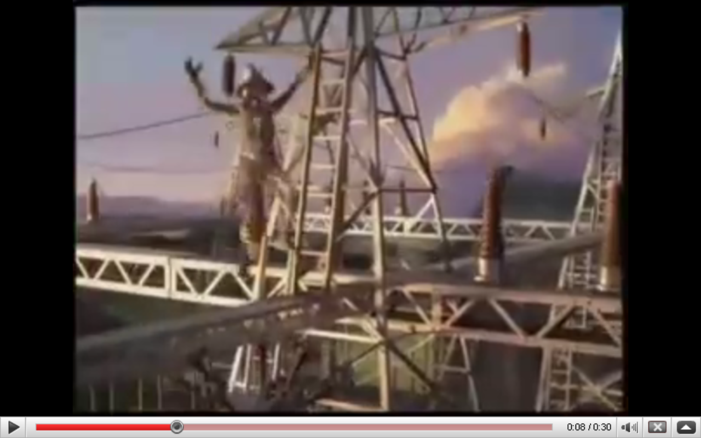
The Smart Grid: Not quite as Dumb as They Think
Source: GE SmartGrid Superbowl ad; https://www.youtube.com/watch?v=Mtdv2FCJMBc

Slide 9
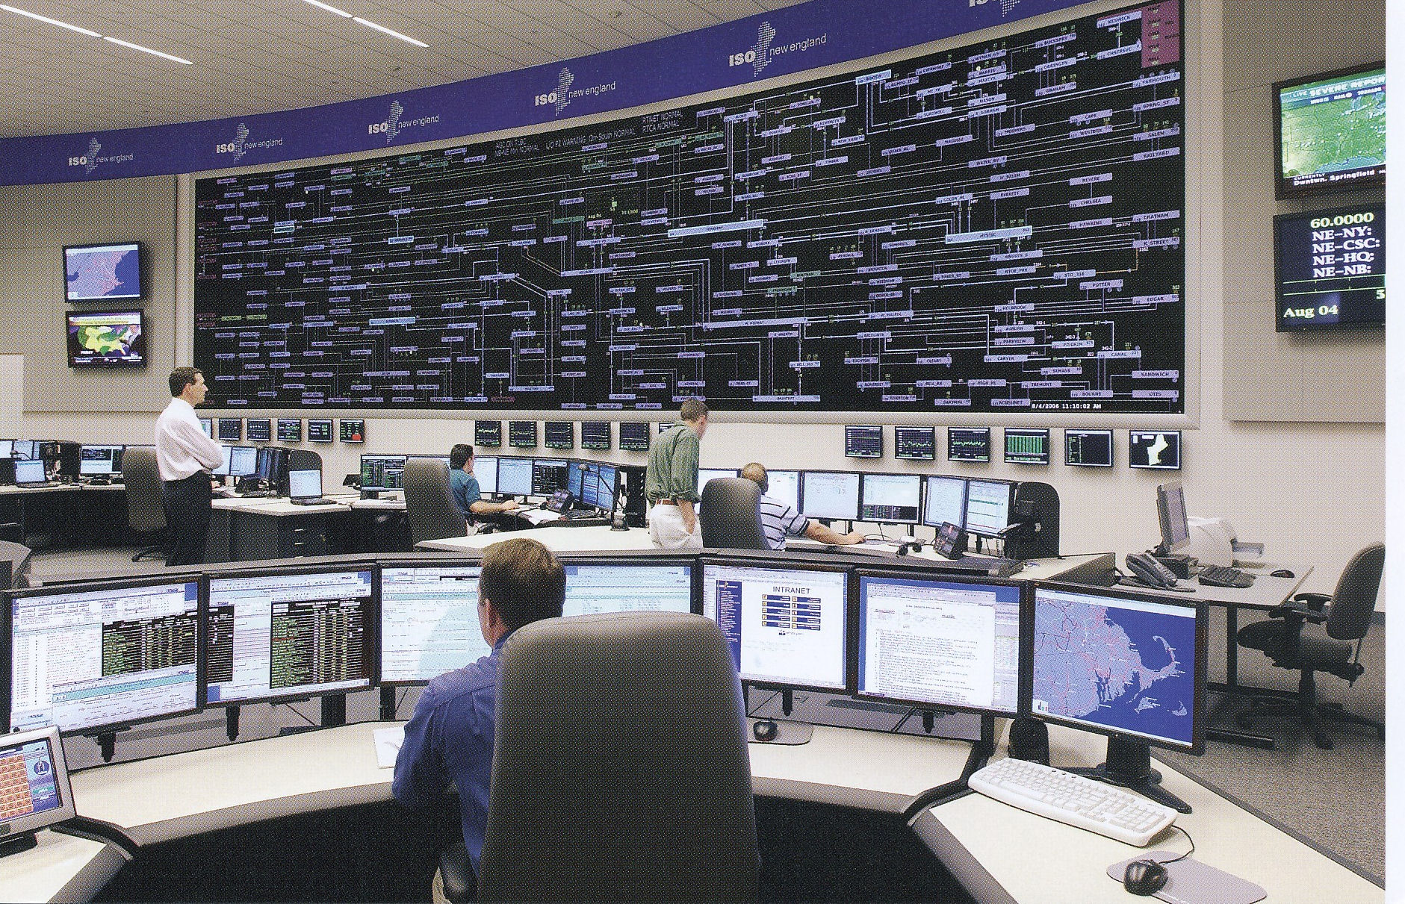
Electric Utilities have Been Leaders in the Use of Technology
ISO New England Control Center

Slide 10
Key Drivers for Smart Grid: Control and Improved Reliability
Key needs for the Smart Grid idea are to allow for the integration of much more non-controllable electric generation like wind and solar, and improved customer reliability
Adding electric vehicle loads also requires charging control
Germane Power Grid characteristics
Electric energy cannot be economically stored
Electric power flow is difficult to directly control
Customers have been in complete control

Slide 11
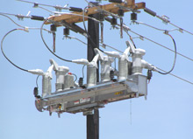
Smart Grid and the Distribution System
Distribution system automation has been making steady advances for many years, a trend that should accelerate with smart grid funding
Self-healing is often used to refer to automatic distribution system reconfiguration
Some EMSs already monitor portions of the distribution system
S&C IntelliRupter® PulseCloser

Slide 12
Smart Grid and Controllable Load
A key goal of the smart grid is to make the load more flexible (controllable). One advantage (to utilities) of smart meters is the ability to remotely disconnect folks.
This requires 1) two-way communication, and 2) at least some loads equipped with controls
The best methods for achieving this control are still being considered. Communications is key, with the “last mile” the key challenge.
Potential options are 1) use existing customer broadband connections, 2) broadband over power line (BPL), 3) meshed wireless

Slide 13
The Smart Grid Starts at the Meter
Traditional electric meters integrated the electric demand and had no communication capability
needed to be read manually.
Newer meters have the ability to measure the demand on a second by second basis, and have at least some communication capability
Can be used to provide consumer access to their electric demand, and also can be used by the utility to remotely disconnect customers

Slide 14
Electric Vehicles
The real driver for widespread implementation of controllable electric load could well be pluggable hybrid electric vehicles (PHEVs) or completely electric vehicles
Recharging PHEVs when their drivers return home at 5pm would be a really bad idea, so some type of load control is a must.
Range on the all electric Tesla Model S (shown above) is about 270 with a 85 kWh battery
Image: www.teslamotors.com/models/drive

Slide 15
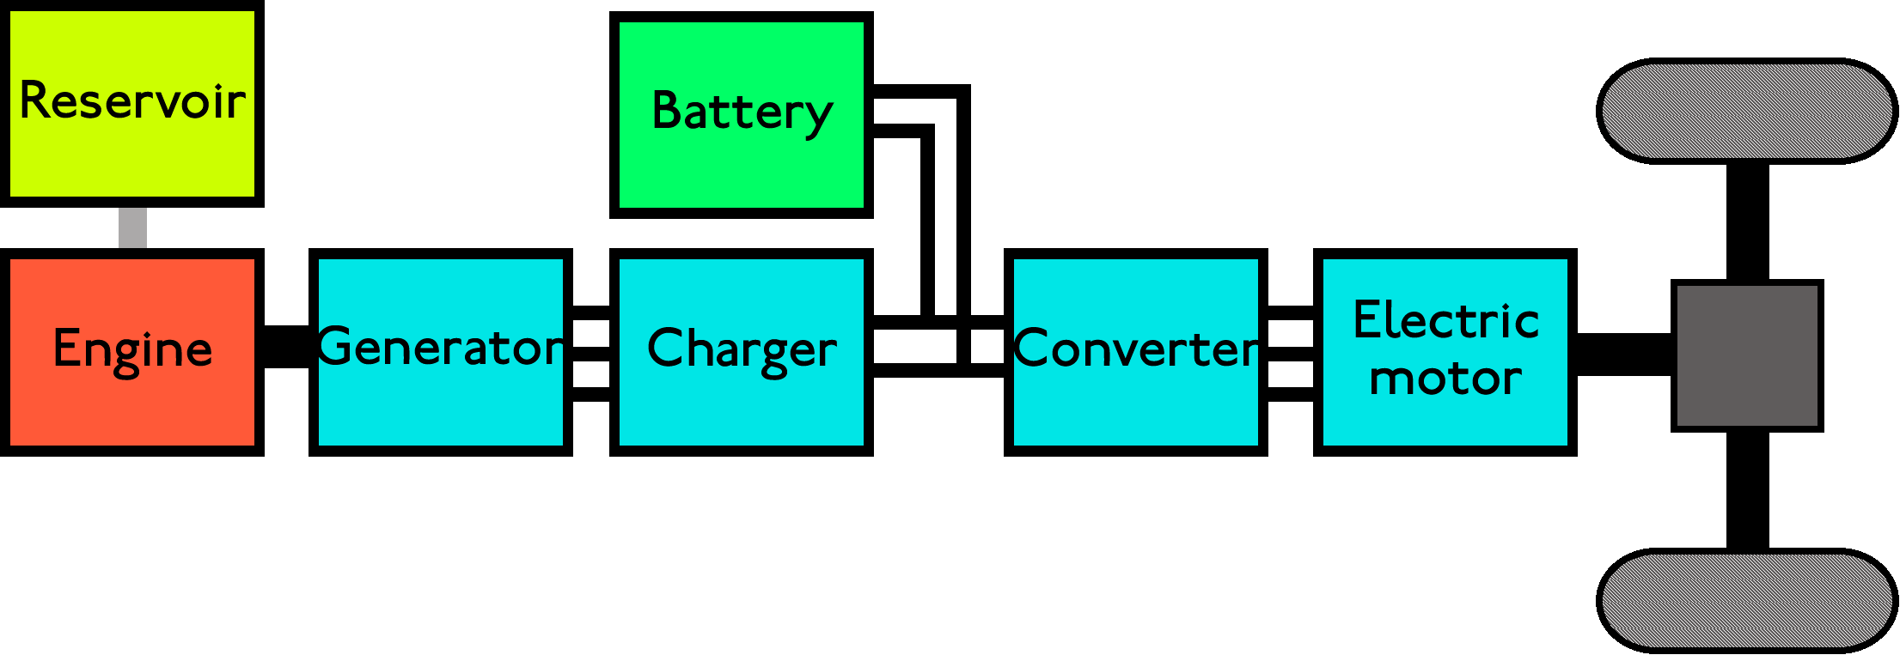
PHEVs
PHEVs give the range of a gas vehicle with the lower cost of an electric vehicle, allowing all electric travel for about 40 miles with an energy storage capacity of around 10 to 17 kWh
One gallon of gasoline has 36.6 kWh but the energy in the battery can be used with a much higher efficiency than that stored in chemical form in gasoline

Slide 16
PHEV Charging Rate and Demand
Power demand and time required to fully charge depend upon the energy needed and the charging voltage
A standard 120V, 20A outlet change provide a maximum of about 1.5 kW, requiring 6 hours to provide 9 kWh.
A 240V, 60A outlet could provide the same charge in about 1 hour at 9.0 kW.
Having people in a neighborhood trying to simultaneously charge their cars at high rates could overload the distribution system

Slide 17
PHEV and EV Sales
Sales have increased from 17,000 cars to 2011 to 52,000 in 2012, 97,000 in 2013 and 123,049 in 2014
Total US car sales in 2014 were about 8 million
http://insideevs.com/monthly-plug-in-sales-scorecard/

Slide 18
Duration and Costs of Blackouts
Cost of blackouts is difficult to determine since electricity has vastly different values. Typical values for a one hour blackout range from a few dollars per kW for residential customers to up to one hundred for industrial and commercial customers.
Average is several hours of outages per year with the fast majority of the outages due to distribution issues. Weather accounts for about 70% of blackouts, with most affecting a relatively small number of customers.
http://www.eei.org/ourissues/electricitydistribution/Documents/UndergroundReport.pdf

Slide 19
Predicted Growth in US Biomass Electric Generation
The assumed growth rate for biomass electricity is about 3.8% per year. Note total renewables by 2040 are still only about 16% of the total (850 out of 5056 TWh).
Source: DOE EIA Annual Energy Outlook 2015

Slide 20
Predicted US Renewable Capacity Additions
Source: DOE EIA Annual Energy Outlook 2015

Slide 21
A Caution About Predictions
Bars tell when the selected resource will run out (based on 1969 consumption, assuming no new reserves). So according to the predictions in 2015 we should have severe shortages, yet commodity prices are low.
Source: Science Year, The World Book Science Annual, 1969, Field Enterprises Educational Corporation, Chicago, IL, 1969

Slide 22
The Changing Grid: New Generation
Light blue dot is TVA's 1200 MW Watt's Bar Nuclear, scheduled to come online in 12/2015
Source: EIA Electricity Monthly, Feb 2015

Slide 23
The Changing Grid: Retirements
Source: EIA Electricity Monthly, Feb 2015

Slide 24
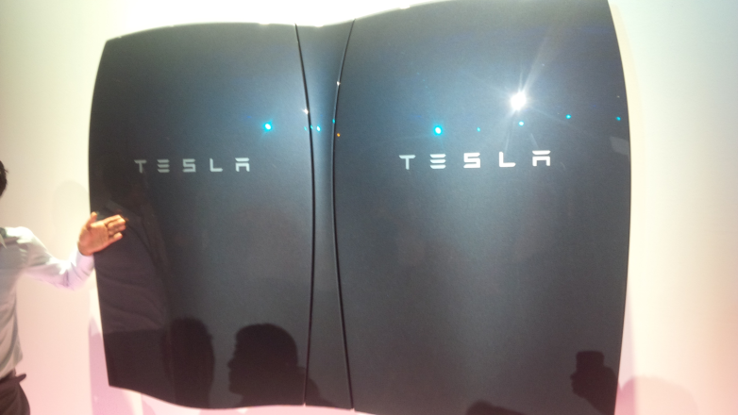
In the News: Tesla Announcement
On 4/30/15 Tesla Motors announced their home batteries
7 kWh for $3000 (optimized for daily use) and 10 kWh for $3500 (optimized backup use)
Multiple batteries could be installed
92% round trip efficiency
Uses lithium ion batteries with liquid thermal control
2 kW continuous , 3.3 kW peak
Weight is 100 kg
Installation and inverter not included
Image: d290b3p3ki7y5s.cloudfront.net/wp-content/uploads/2015/05/Tesla-PowerWall.jpg?b09674

Slide 25
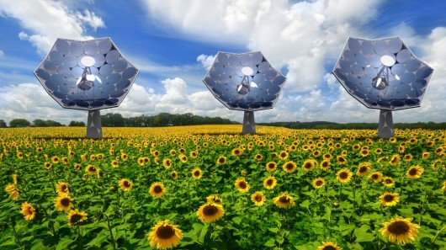
In the News: IBM High Concentration PV
System uses a parabolic dish to concentrate sunlight up to 2000 times onto triple junction solar PVs
Each 1 by 1 cm chip can convert 50 W with 80% efficiency; liquid cooling is used
Uses tracking system to follow the sun
Under development by Airlight Energy Solutions
http://www-03.ibm.com/press/us/en/pressrelease/40912.wss
Image: www.airlightenergy.com/

Slide 26
Combined Heat and Power (CHP)
Some generation technologies produce usable waste heat, and some industries have heat or steam demands
Examples: refineries and chemical plants
Higher temperature waste heat is more versatile
Using waste heat can displace the need to buy electricity or an expensive fuel such as propane
One challenge is to appropriately time the use of the electric and thermal energy
Sometimes called cogeneration

Slide 27
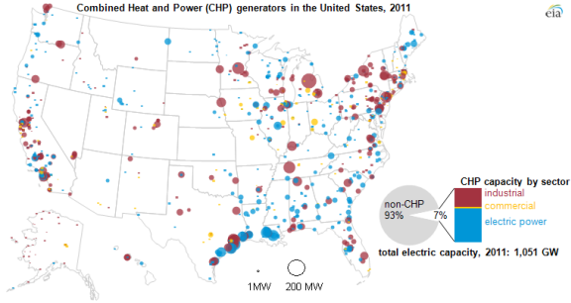
US Locations of CHP
Some are associated with the paper industry
Notice Gulf Coast locations, mostly for refineries
Image Source: www.eia.gov/todayinenergy/detail.cfm?id=8250

Slide 28
Current Status
2010 and 2011 continued downward trend, 1.57 and 1.55 quad respectively with a peak in 2000 of 2.3 quads.
Source: EIA 2012 Energy Annual

Slide 29
CHP Efficiency – Simple approach
Difficult to quantify – the value of a unit of electricity is much higher than a unit of thermal energy
Simplest approach:
Doesn’t distinguish between the two types of energy

Slide 30
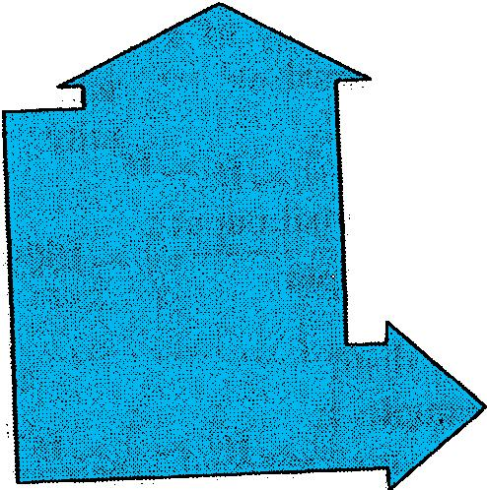
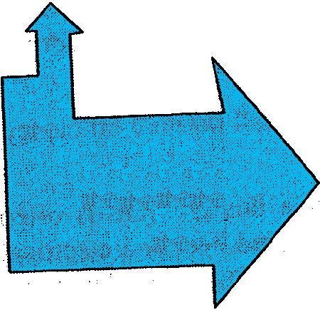
Evaluating CHP Efficiency
Compare CHP to separate heat and power with up arrows indicating waste
CHP can be a better approach
Drawback - need to estimate efficiency of the boiler
Cogeneration Plant
Electricity
Heat

Slide 31
Evaluating CHP Efficiency
60 units waste heat
22 units waste heat
90 units input
heat
33 % efficient grid
100 units input
heat
30 units electricity
30 units electricity
Electricity
12 units waste heat
48 units thermal
60 units input
heat
Cogeneration Plant
80% efficient boiler
48 units thermal
100 units input -> 78 units output
Heat
150 units input -> 78 units output

Slide 32
Evaluating CHP Efficiency
Combined Heat and Power
Separate Electricity and Heat
100 units input -> 78 units output
150 units input -> 78 units output
Without CHP, we need more input for the same output

Slide 33
CHP Overall Energy Savings
Combined Heat and Power
Separate Electricity and Heat
100 units input -> 78 units output
150 units input -> 78 units output

Slide 34
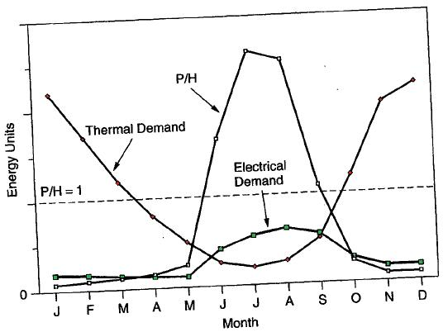
Design of CHP Systems
Inherently challenging
Power-to-heat-ratio of equipment may be constant, but demand of power and heat changes
Notes:
Should you size a fuel cell to deliver peak electric power or all the thermal power?

Slide 35
Cooling, Heating, and Cogeneration
P/H ratio of buildings varies greatly, and we want to smooth it out:
Heat Pumps - Use electricity instead of heat
Absorption Cooling (Absorption Refrigerator) - Use heat instead of electricity in the summer
Uses a liquid with a low boiling point (less than 0° F)
Liquid refrigerant evaporates at low pressure, removing heat
The now gas refrigerant is absorb into another liquid (such as a salt solution), reducing pressure, allowing more evaporation
Liquid is heated causing evaporation at high pressure, then condensed in a heat exchanger
Not efficient so only used when heat is available

Slide 36
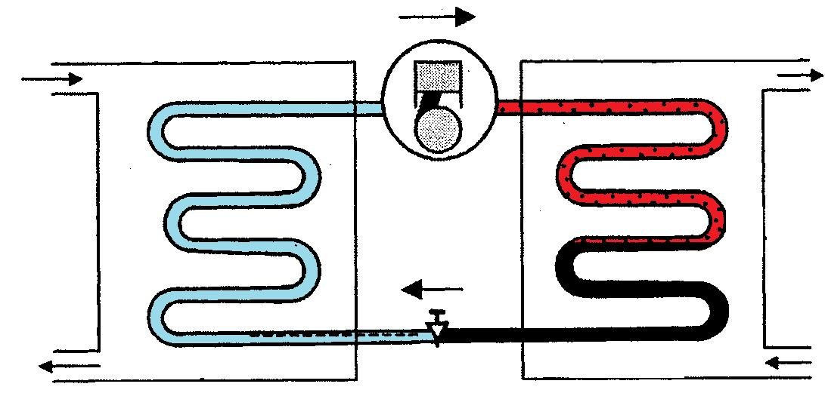
Vapor-Compression Refrigeration
Compressed fluids get colder when they expand, and hotter when compressed
Compressor – refrigerant enters at low pressure, exits high
Condenser – cools and condenses from gas to liquid
Expansion Valve – pressure decreases
Low pressure vapor
High pressure vapor
50˚F
50˚F
120˚F
95˚F
Evaporator Coil
Condenser Coil
Compressor
45˚F
38˚F
Expansion Valve
100˚F
85˚F
Low pressure vapor/liquid
High pressure liquid
Notes:
35

Slide 37
Refrigeration Cycle Coefficient of Performance (COP_{R})
A measure of refrigeration cycle efficiency
Q_{L} = heat extracted from refrigerated space
W = work put into compressor
Dimensionless - Q_{L} and W must have the same units
Tells how many units of heat are removed for each unit of energy consumed by the A/C
Want this to be high- if it is low, you need more electrical input to provide the desired heat output
Notes:
36

Slide 38
Energy Efficiency Rating (EER)
Another way to express refrigeration cycle efficiency
Typical EER for A/Cs is 9 to 17 Btu/W-hr (at 95° F)
Related to COP_{R} by
Seasonal Energy Efficiency (SEER) – an average rating over the course of the heating season. Above 13 is one requirement
Notes:
37

Slide 39
One “ton” of cooling
The rate heat is absorbed when a 1 ton block of ice melts over the course of a day Note this is just a unit comparison. One ton of cooling is associated with heat transfer, not (directly) electrical consumption.
Notes:
38

Slide 40
One “ton” of cooling, cont.
Another efficiency measure – tons/kW of cooling:
A 3-ton home-sized A/C uses approximately 2-3kW
Chillers can make ice at night to melt during the day

Slide 41
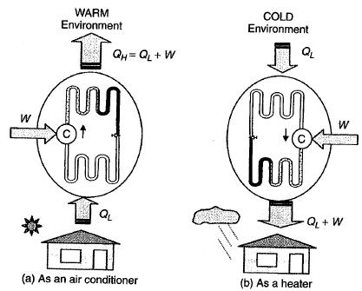
Heat Pumps
Move heat from a source to sink
Have the ability to be reversed – provide heating and cooling
Figure 5. 15
Notes:
40

Slide 42
Heat Pumps
Heat pumps, when used as a heater, deliver Q_{L} (heat removed from cold environment)+W (compressor energy) = Q_{H}
Relationship between COP_{HP} and COP_{R}
The vapor-compression refrigeration device shown earlier is a heat pump
Notes:
41

Slide 43
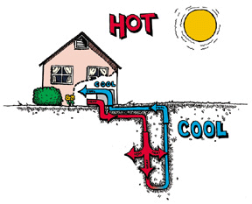
Ground Source Heat Pumps
Key idea: ground temperature below surface is relatively constant
Good for use in climates with cold winters and hot summers
Have very high COPs
Four basic designs: vertical, horizontal, pond/lake,open
http://www.igshpa.okstate.edu/geothermal/geothermal.htm
Notes:
42

